Slide 1
My AWS Environment and how I got there
A summary of my past few months of intensively trying to grasp a hold of cloud… and succeeding in it

Slide 2
It all started in April…
AWS Cloud Fundamentals course in Laurea UAS (April–May, 3 ECTS)
Cloud Concepts Overview
Cloud Economics and Billing
AWS Global Infrastructure
AWS Cloud Security
Networking and Content Delivery
Compute
Storage
Databases
Cloud Architecture
Automatic Scaling and Monitoring

Slide 3
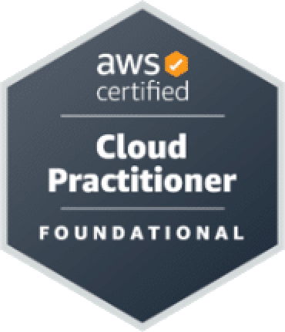
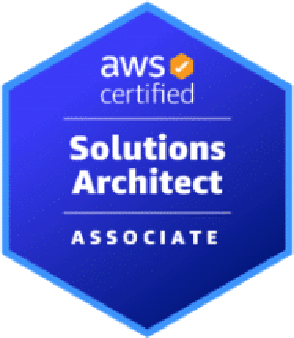
…and continued into the summer
AWS Certified Cloud Practitioner CLF-C02 June 12, 2025
Cloud Concepts
Security and Compliance
Cloud Technology and Services
Billing, Pricing, and Support
AWS Certified Solutions Architect SAA-C03 July 28, 2025
Designing Secure Architectures
Designing Resilient Architectures
Designing High-Performing Architectures
Designing Cost-Optimized Architectures

Slide 4
There’s been a lot of effort to get better and to achieve the certs
Hundreds of hours spent in AWS Skill Builder
Certification learning paths consisted of
Learning videos
SimuLearn labs
Escape Room games
Cloud Quest games
Practice exams
See more of more detailed information on the skills I’ve acquired through this journey at the end of the presentation

Slide 5
The Environment

Slide 6
My AWS environment
I built my own AWS environment utilizing many different AWS services
I migrated applicable parts of my already existing digital resources (e.g. web apps on Netlify, projects on GitHub) into AWS Cloud
There’s three main components I focused on migrating
My website jonimakinen.com
A simple full stack app Translation Game
An SPA study tracker on the web Curriculus
I built microservice applications around these main components
Different AWS services play together to form fully functioning applications in the cloud

Slide 7
Let’s first take a quick look at the migrated main components

Slide 8
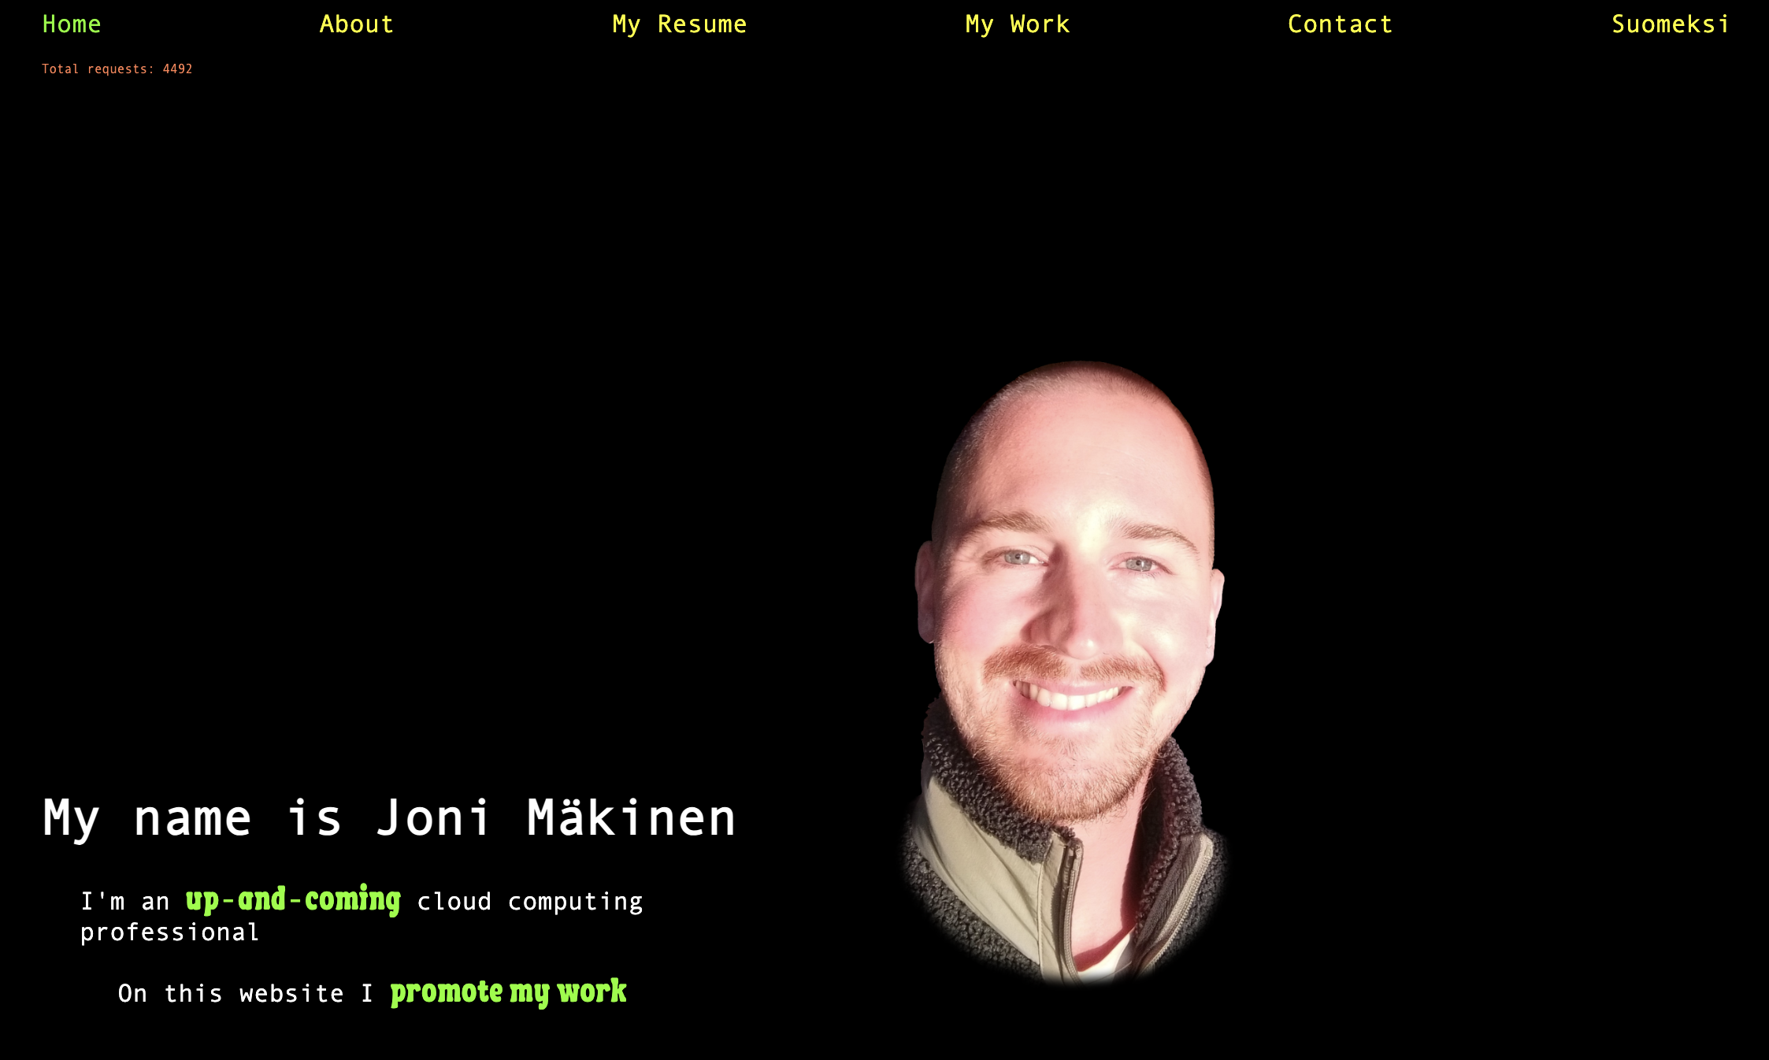

Slide 9
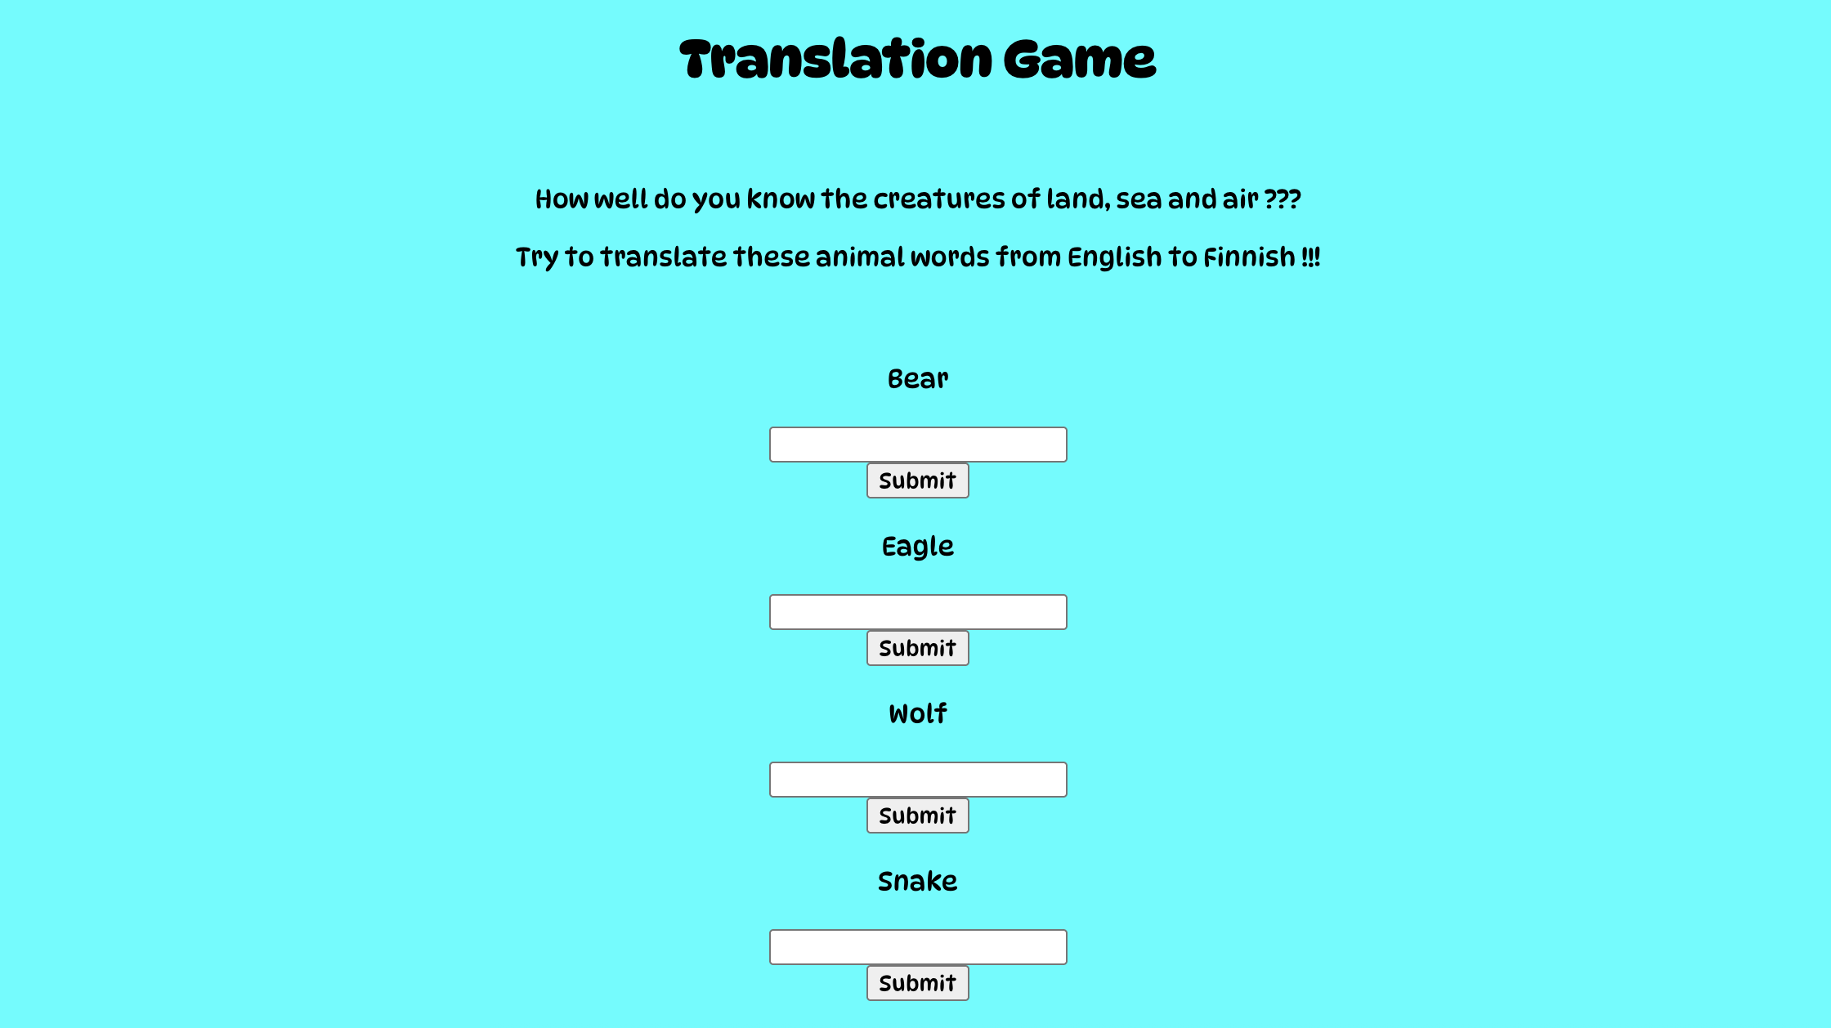

Slide 10
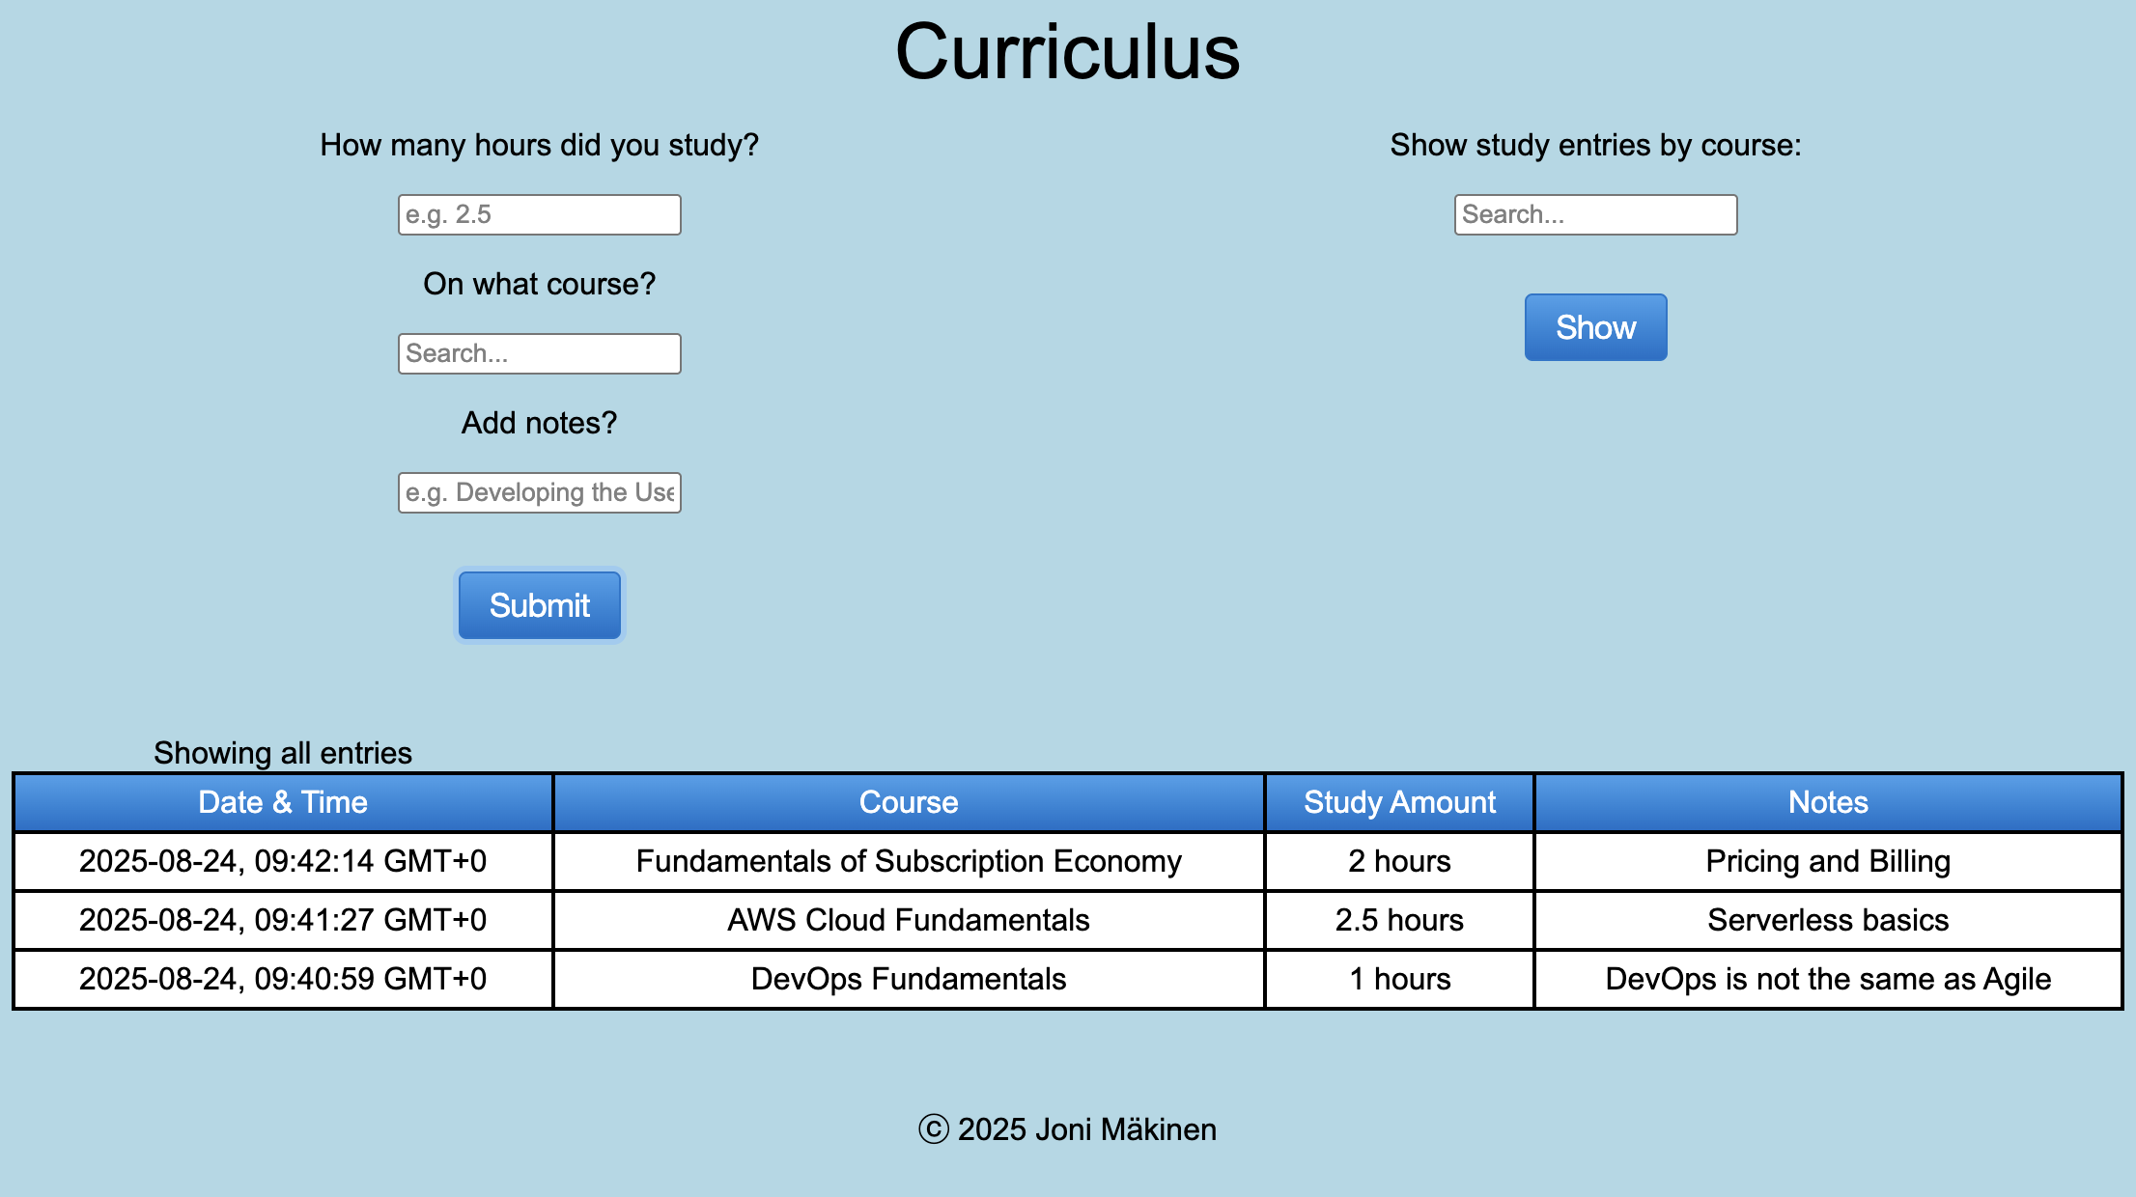

Slide 11
Let’s then delve into the microservice applications

Slide 12

Microservice applications
There are 5 different applications I’m about to present to you
1. Static Website Hosting
2. Website Request Counting built around jonimakinen.com
3. Email Notification
4. Application Hosting (VPC) built around Translation Game
5. API Gateway with Lambda Integration built around Curriculus and DynamoDB Connection
The applications consist of a diverse group of AWS services from different service categories

Slide 13
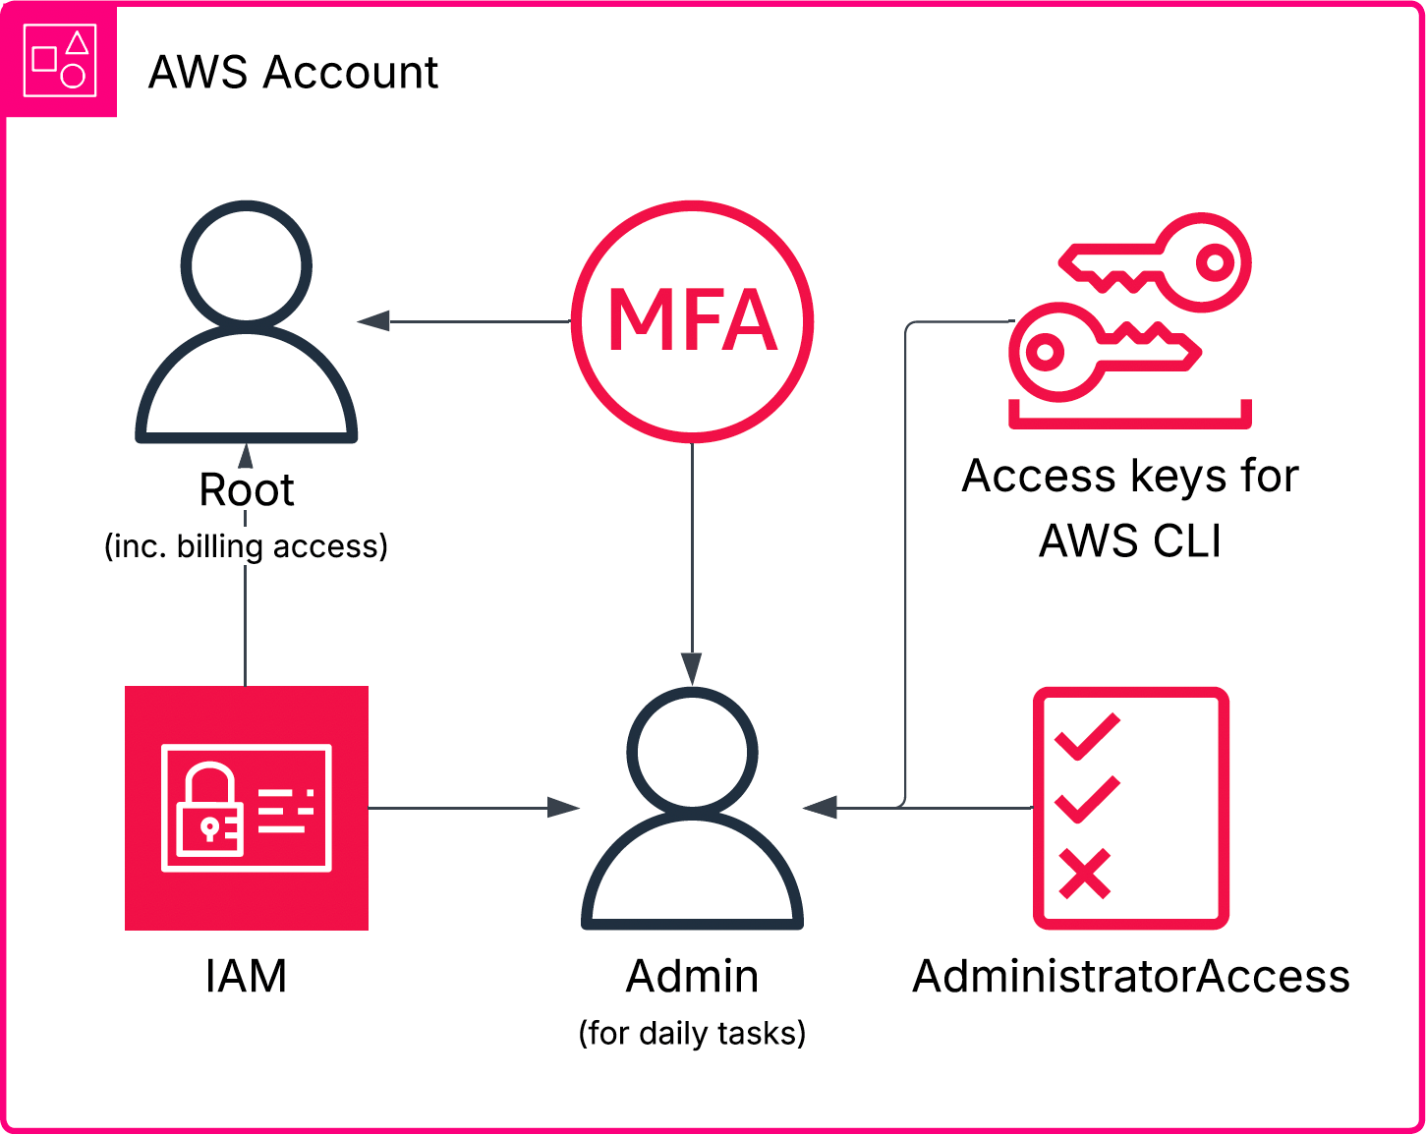
Before we go see the first application…

Slide 14

1. Static Website Hosting Microservice application

Slide 15
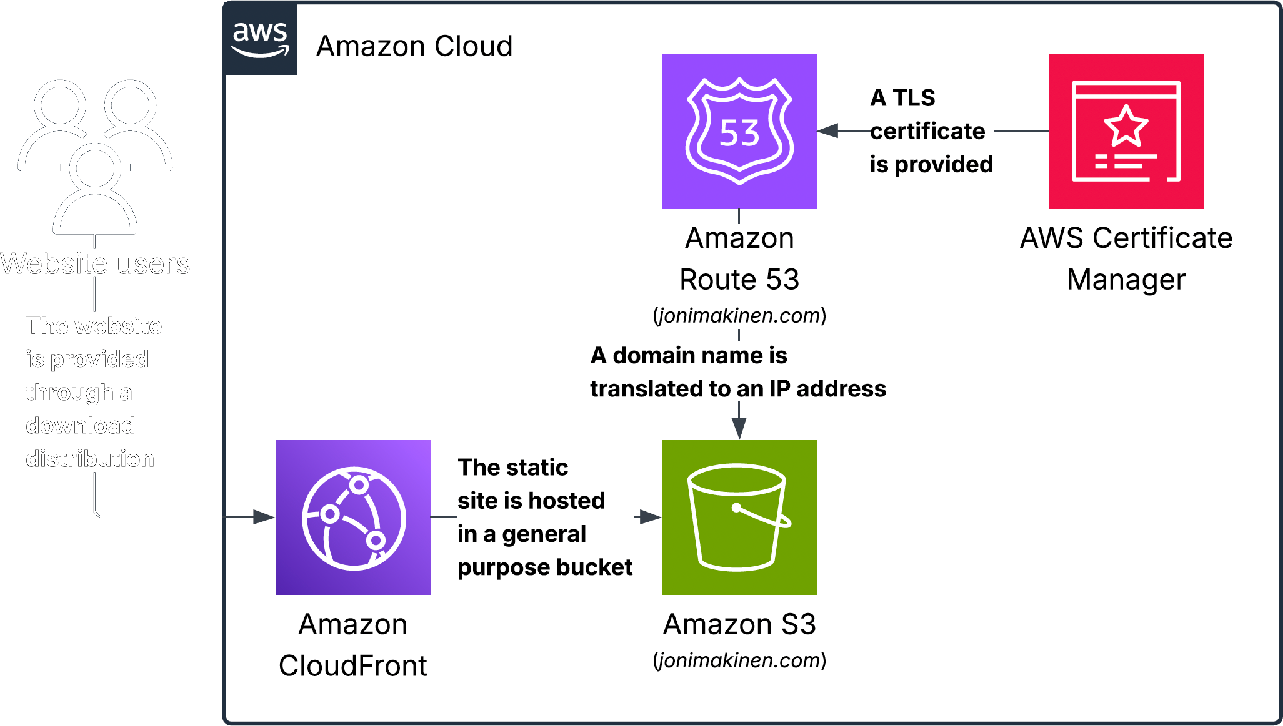
Static Website Hosting jonimakinen.com

Slide 16
2. Website Request Counting Microservice application

Slide 17
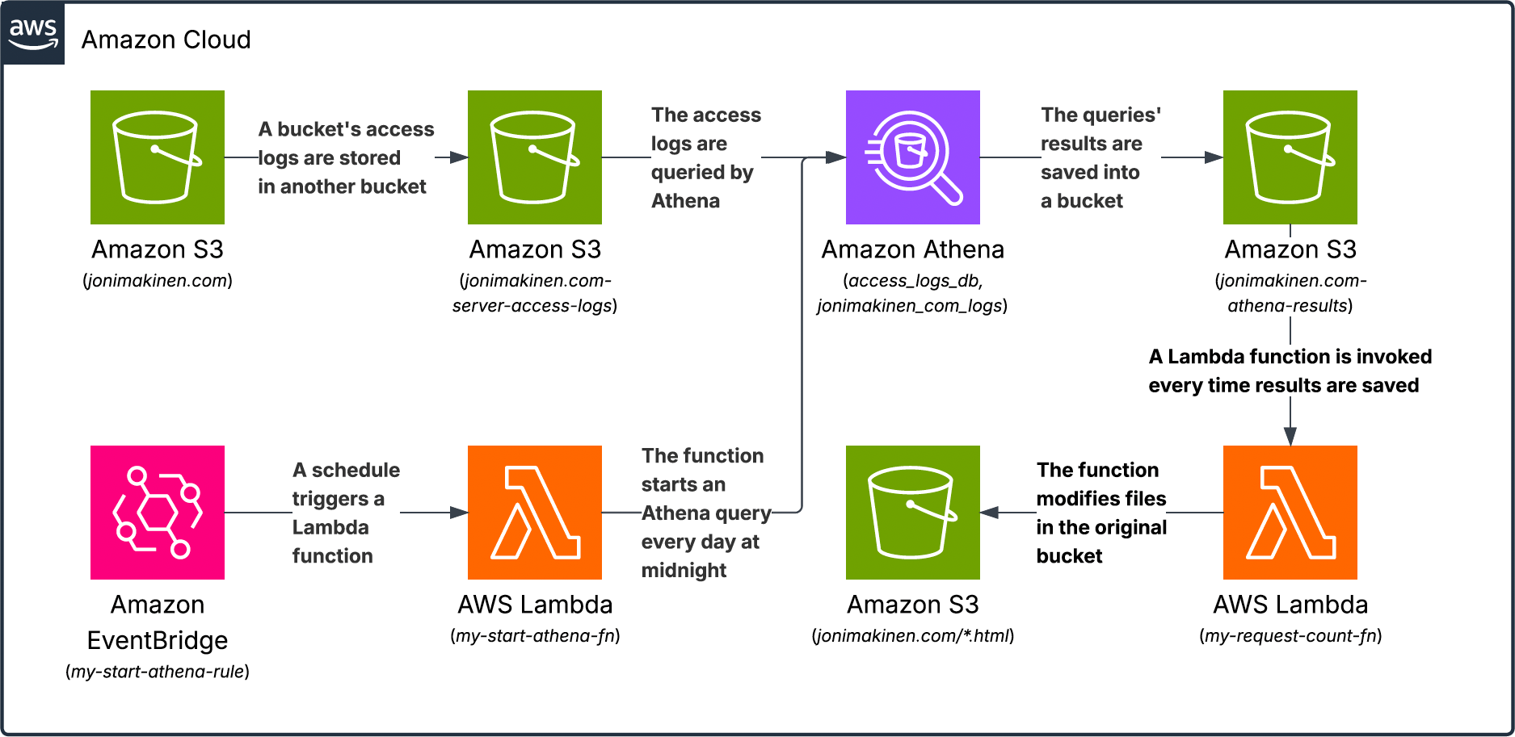
Website Request Counting jonimakinen.com

Slide 18
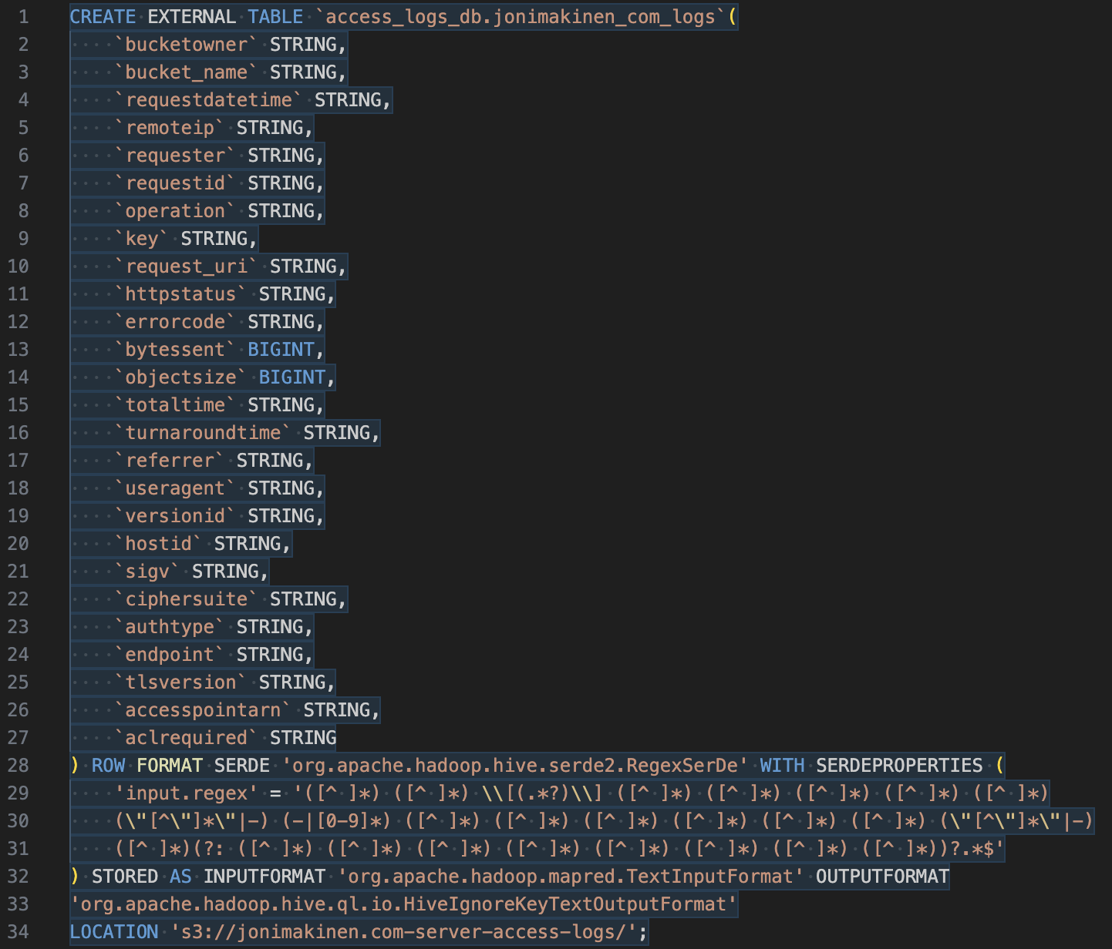
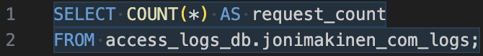
Athena SQL commands Website Request Counting

Slide 19
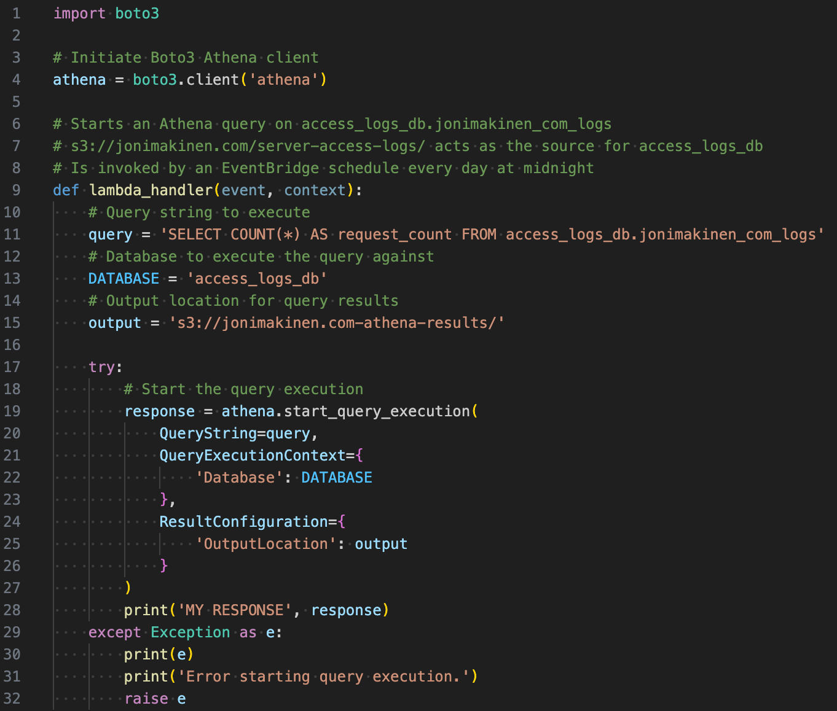
My-start-athena-fn Lambda Website Request counting

Slide 20
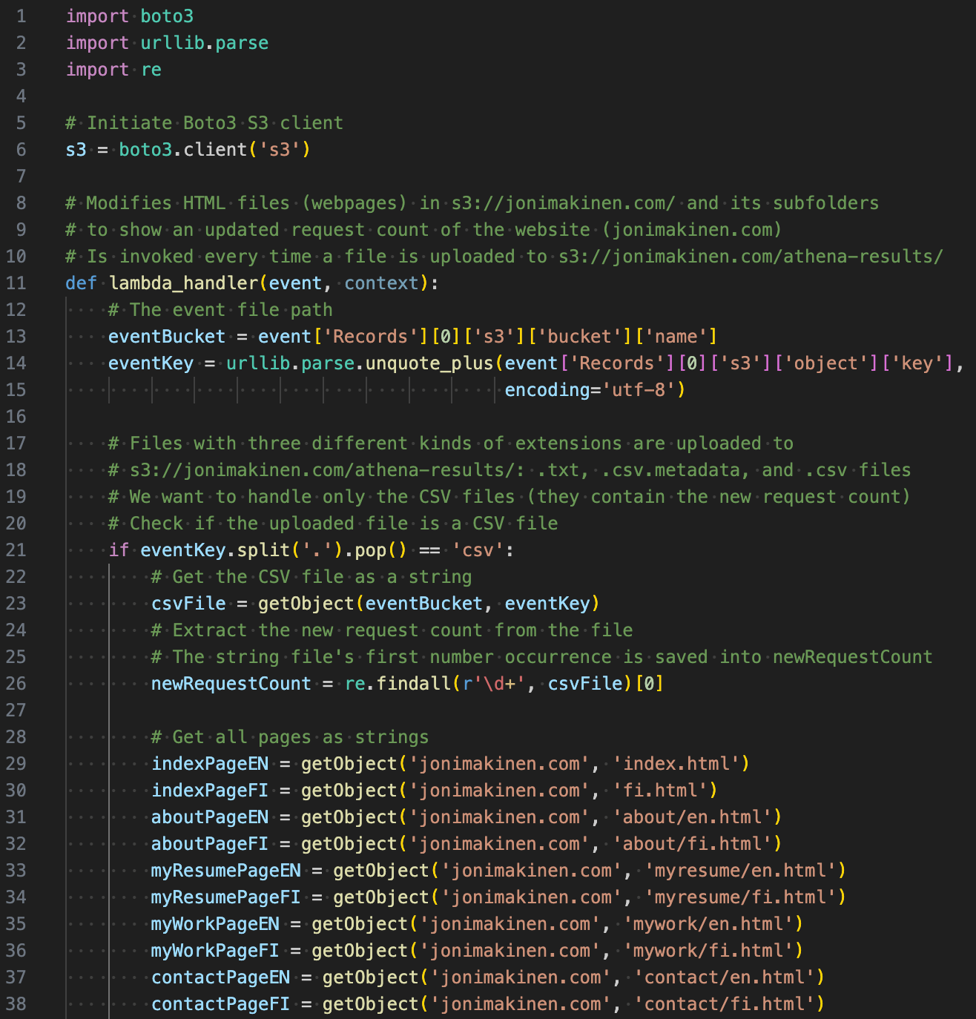
My-request-count-fn Lambda 1/3 Website Request Counting

Slide 21
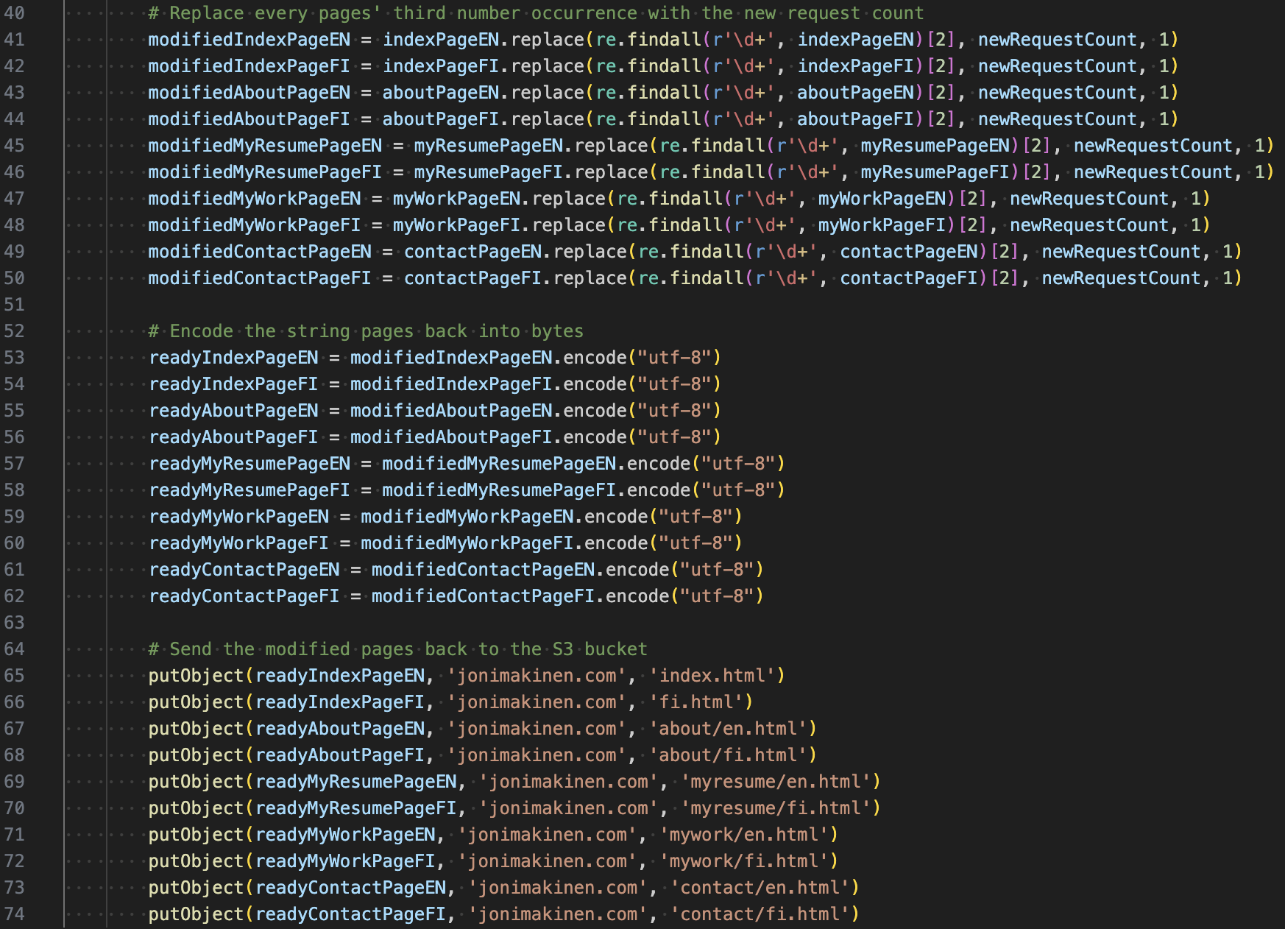
my-request-count-fn Lambda 2/3 Website Request Counting

Slide 22
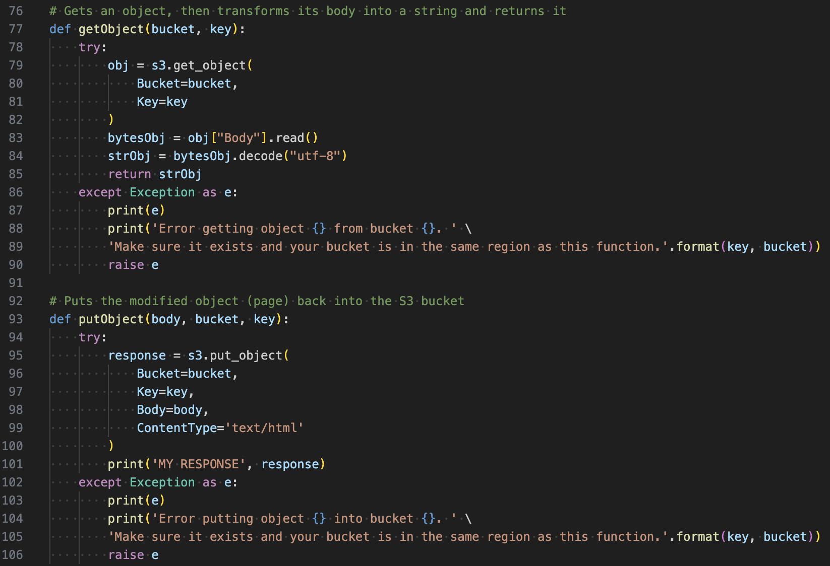
my-request-count-fn Lambda 3/3 Website Request Counting

Slide 23
3. Email Notification Microservice application

Slide 24
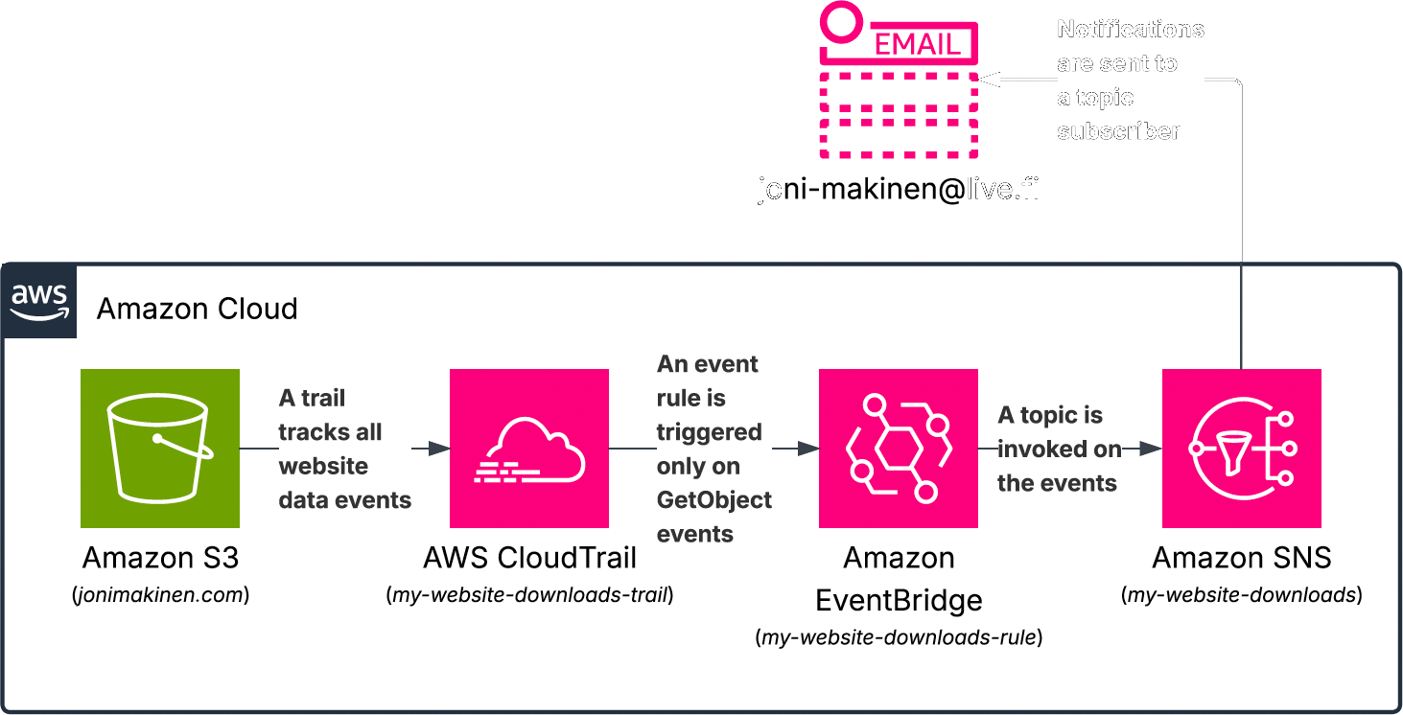
Email notification jonimakinen.com

Slide 25

4. Application Hosting (VPC) Microservice application

Slide 26
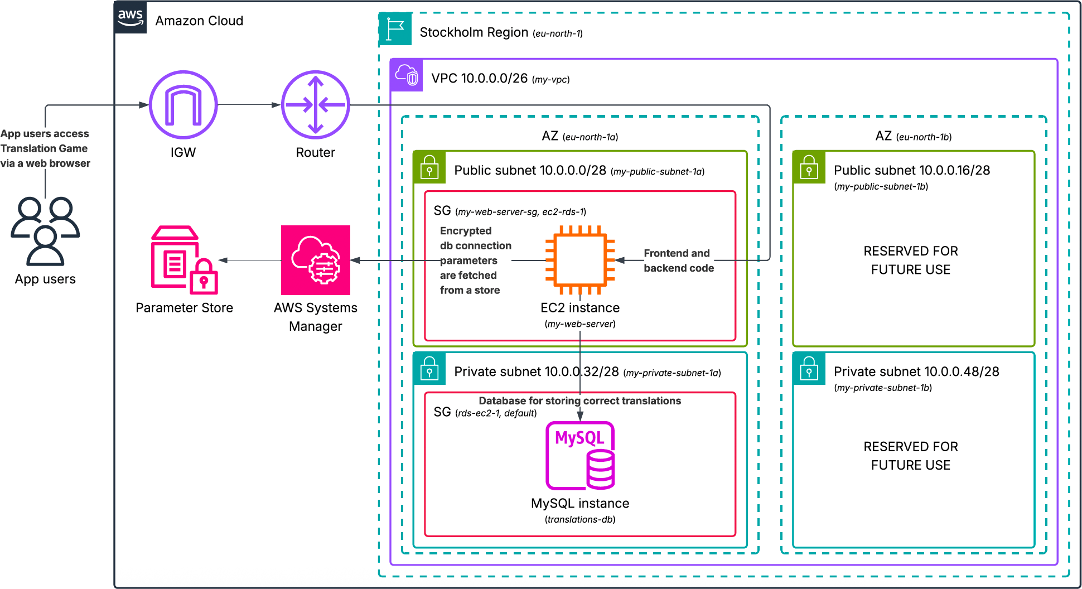
Application Hosting (VPC) a VPC accommodating a 3-tier full stack app

Slide 27
my-web-server EC2 instance Application Hosting (VPC)
Associated with an Elastic IP
Assigned an IAM instance profile to give permission to fetch parameters from AWS SSM Parameter Store
Key pair in use for SSH connections
Launches with user data
Fetches parameters needed for database connection from Parameter Store
Installs needed packages with Yum
Downloads Translation Game from S3
Installs Node.js dependencies
Starts servers on ports 8080 and 3000

Slide 28
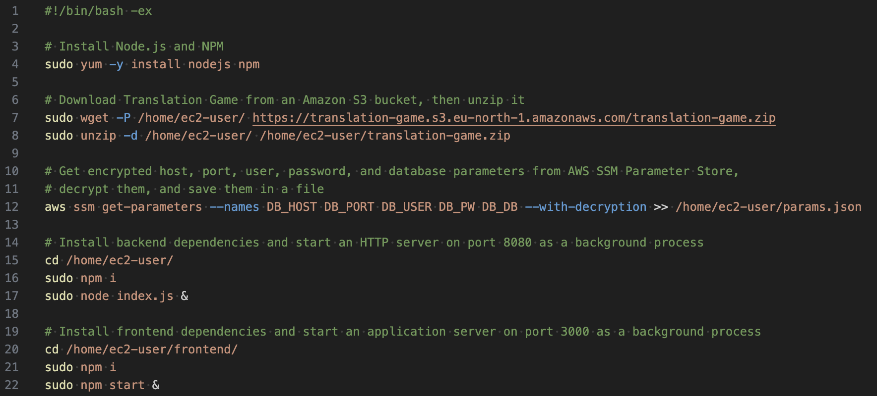
My-web-server user data script Application Hosting (VPC)

Slide 29
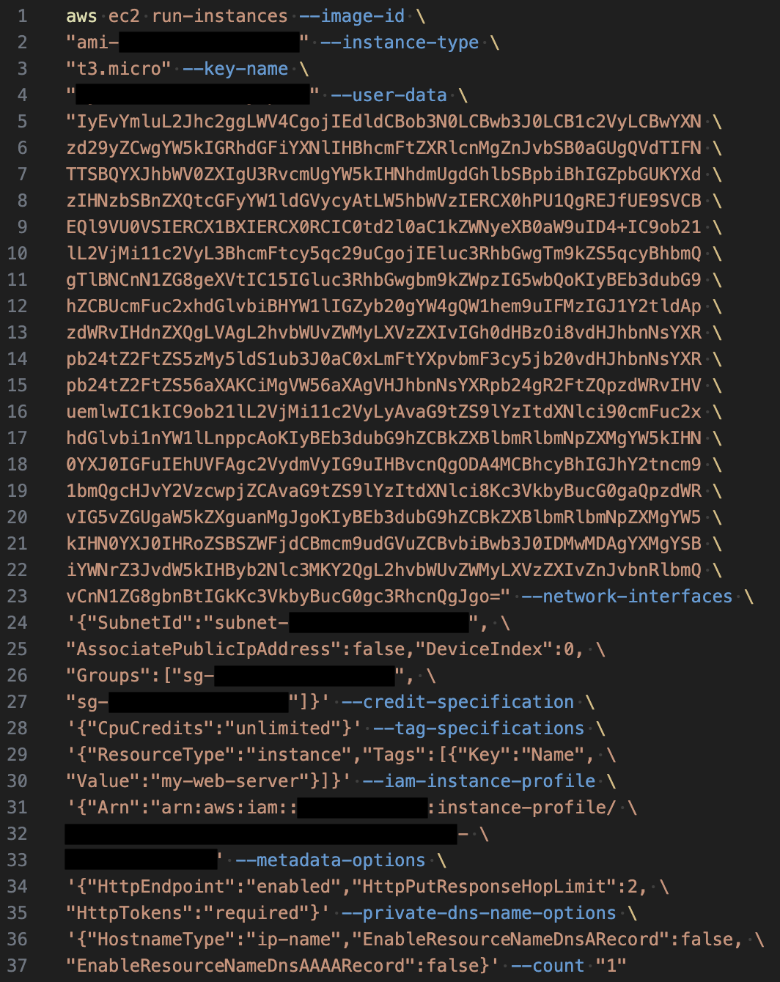
Launching My-web-server via AWS CLI Application Hosting (VPC)

Slide 30
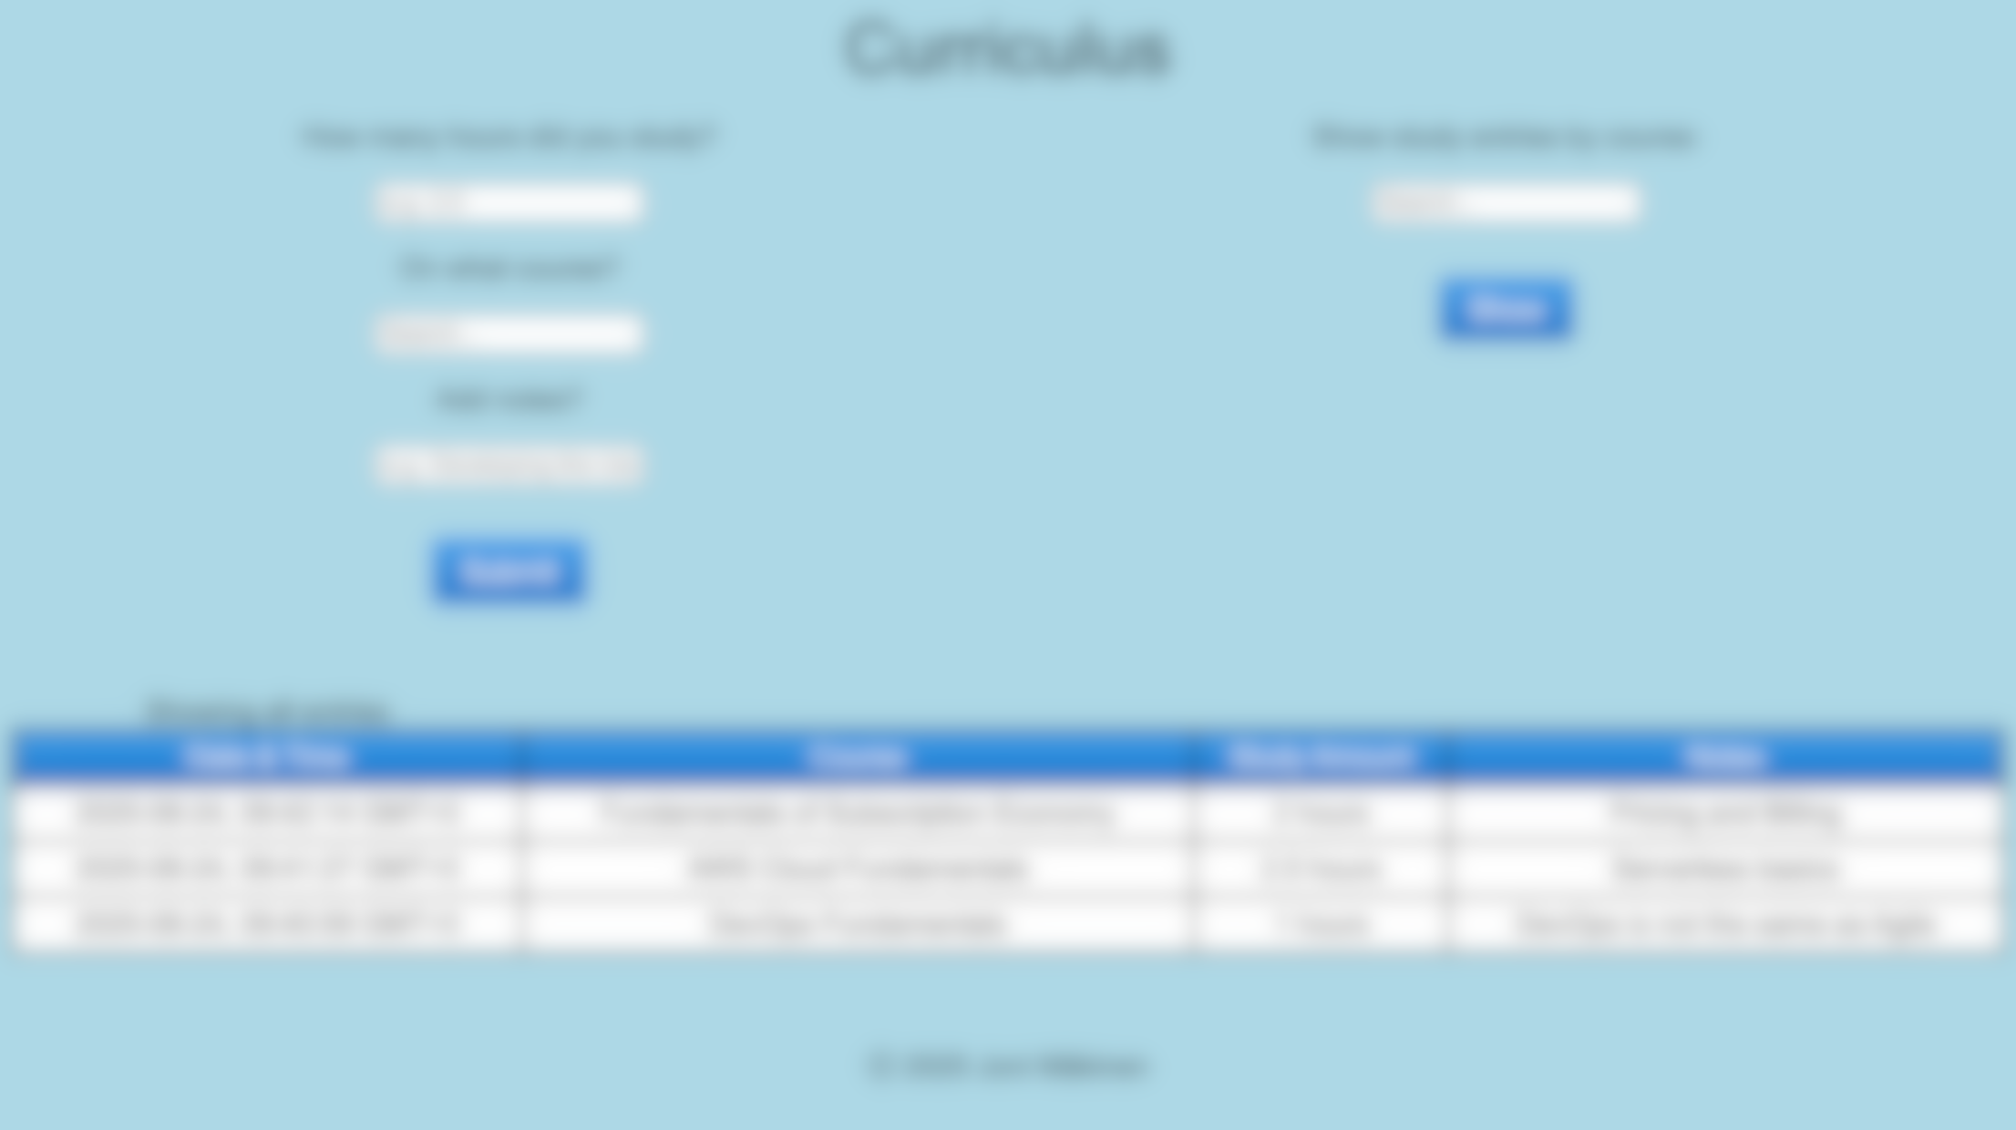
5. API Gateway with Lambda Integration and DynamoDB Connection Microservice application

Slide 31
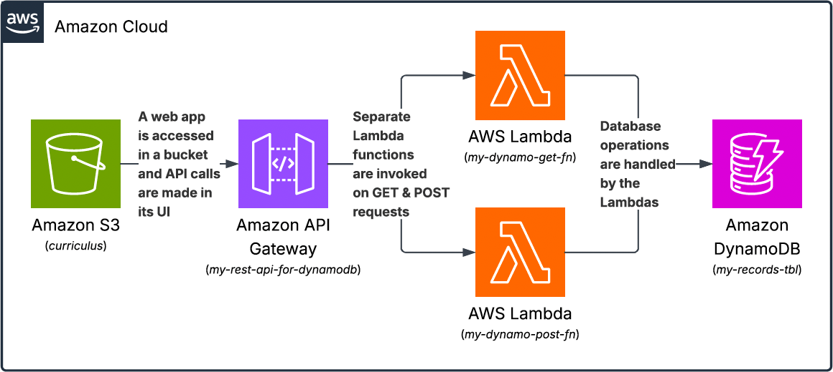
API Gateway with Lambda Integration and DynamoDB Connection Curriculus

Slide 32
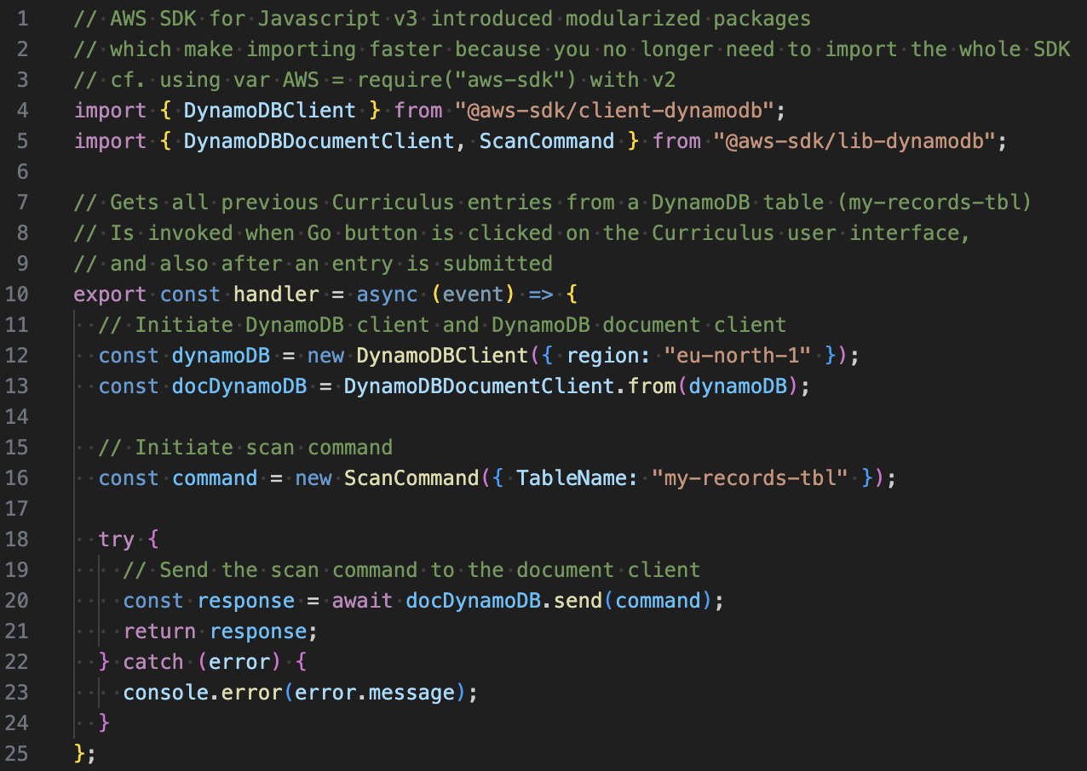
My-dynamo-get-fn Lambda API Gateway with Lambda Integration and DynamoDB Connection

Slide 33
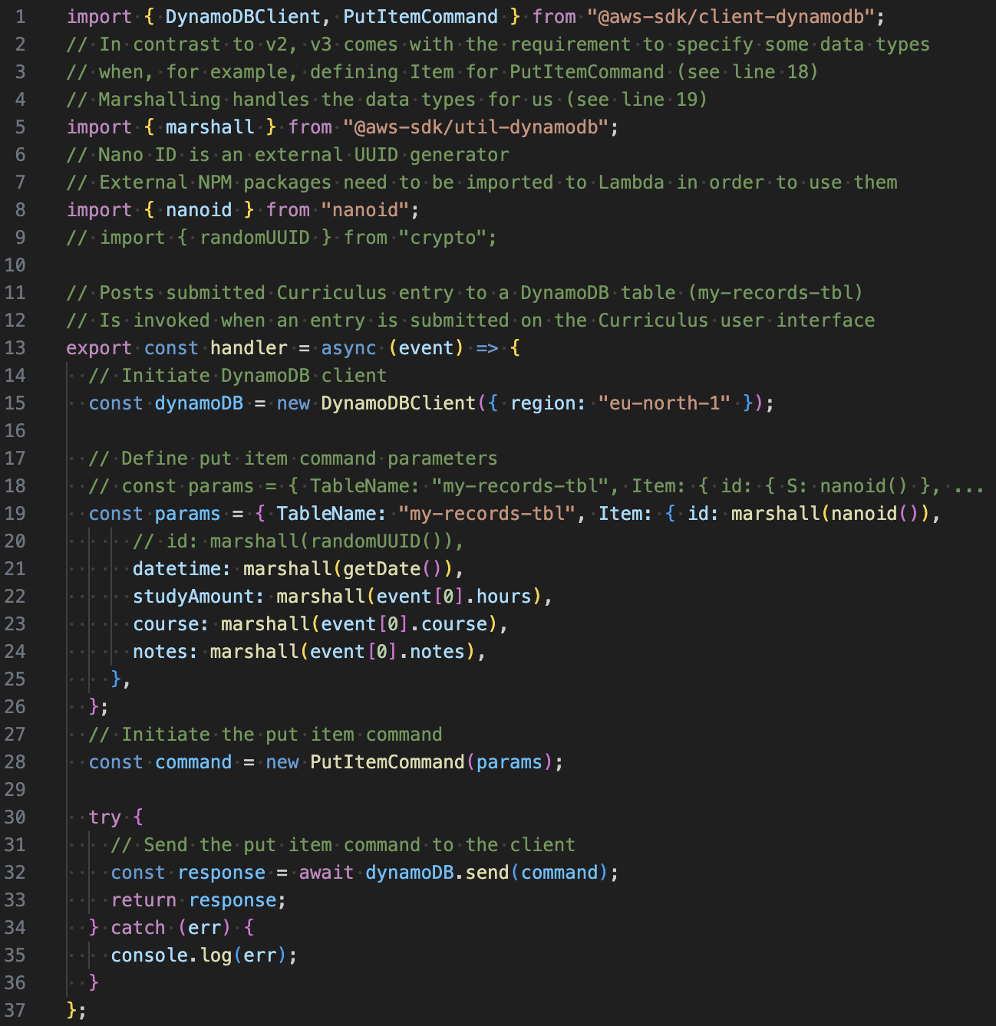
My-dynamo-post-fn Lambda 1/2 API Gateway with Lambda Integration and DynamoDB Connection

Slide 34
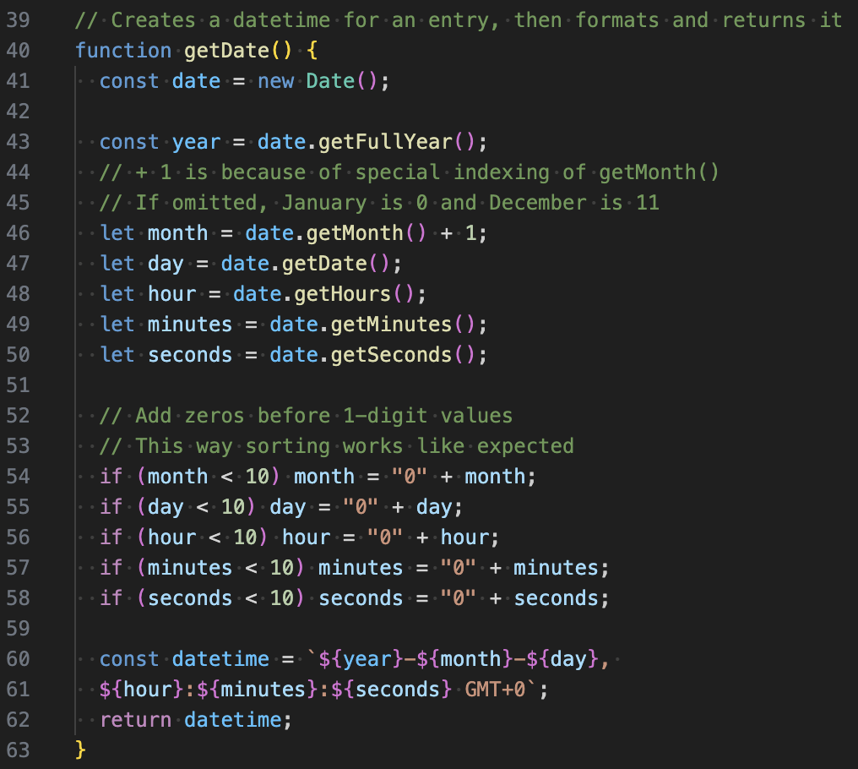
My-dynamo-post-fn Lambda 2/2 API Gateway with Lambda Integration and DynamoDB Connection

Slide 35
What could I have done differently? what could I improve?

Slide 36
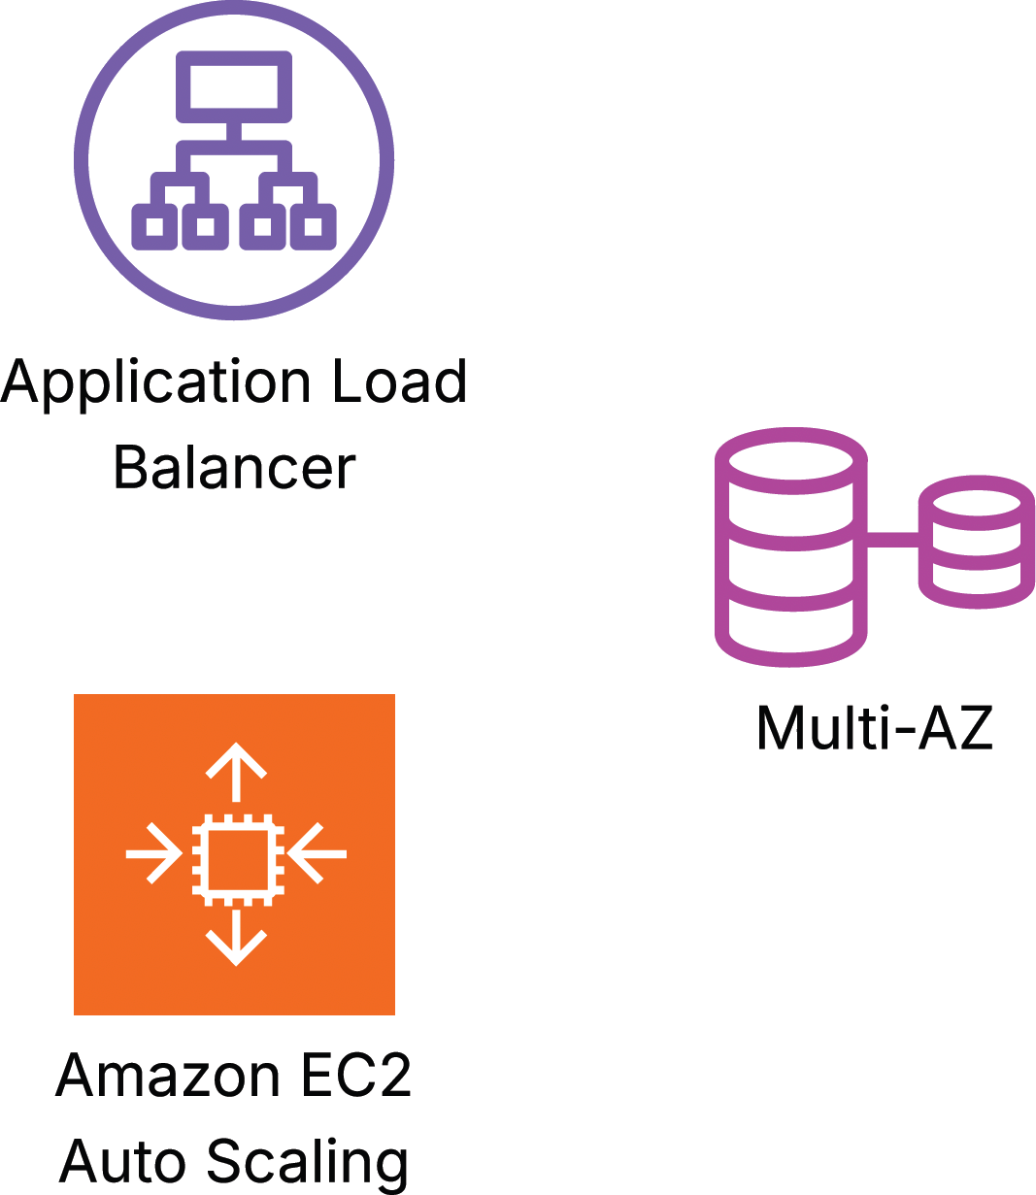
Making resources in the VPC scalable and higher in availability
The VPC could be improved by adding Application Load Balancing and EC2 Auto Scaling
The MySQL instance could be replicated across AZs by using Multi-AZ configuration

Slide 37
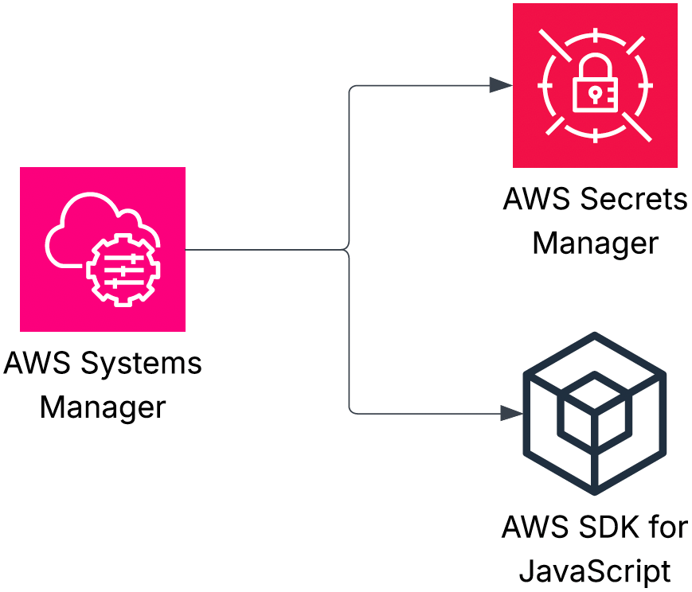
Implementing the database connection parameter storing & fetching in a different way
I could have implemented the storing and fetching of the parameters with AWS Secrets Manager instead of utilizing AWS Systems Manager Parameter Store
Also, using AWS SDK for JavaScript in Translation Game code to fetch the parameters was an option (I actually wrote the code halfway through until I decided to fetch them via my-web-server user data script)
const AWS = require(“aws-sdk”) const parameterStore = new AWS.SSM() parameterStore.getParameters() …

Slide 38

Implementing a sign-in process for Curriculus
In its current state, Curriculus saves every users’ entries into the same DynamoDB table (my-records-tbl), without differentiating the entries by user in any way
This, of course, isn’t the way we want a production-state application to function
A better implementation would be to continue saving the entries into the same table, but starting to differentiate them by user
This could be done by using the partition and/or sort keys to store user differentiating information like usernames
In order to have the users have usernames in the first place, some kind of user registration and sign-in processes should be put into place
Also, a password storing solution is needed
One way to implement all of them is with Amazon Cognito

Slide 39


Scoping roles and permitting least privilege more accurately
Naming some of the used resources accurately has been somewhat challenging
IAM role naming has been especially challenging because of a scoping dilemma
Should I create a role just for this one specific use case? Or should I scope the role permissions so that the role can be used in two or even multiple use cases?
A role’s scope affects its naming significantly
Some of the permissions I’ve assigned to, for example, to roles have more permissions than the resources need to perform the job they’re expected to
When creating a process (e.g. integrating a Lambda function to an EventBridge schedule), it’s been so much easier to get it to work by assigning “extra permissions” than assigning only the exact needed permissions
Some of the processes still have excess permissions that are waiting to be dealt with

Slide 40
An exhaustive list of concepts I’ve gotten practice at 1/3
Amazon VPC
Attaching internet gateways
Creating subnets and configuring their route tables
Configuring network ACLs and security groups
Configuring VPC peering connections between VPCs
Configuring route tables and security groups to allow traffic flow
Creating VPC Flow Logs and sending/publishing the data to S3 buckets (and CloudWatch Logs) to analyze traffic within a VPC
Allocating Elastic IPs and associating them with EC2 instances
Amazon EC2
Managing instance states, changing instance types, and viewing instance metadata
Associating instances with security groups and IAM roles
Launching instances with user data scripts
Connecting to instances (with EC2 Instance Connect and Session Manager), then viewing instance logs
Creating EC2 Auto Scaling groups
Creating AMIs and launch templates
Configuring scheduled scaling
Attaching Application Load Balancers to ASGs
Creating target groups
Configuring target tracking policies
Configuring ALBs to conduct health checks on instances
Amazon Elastic Block Store (EBS)
Creating volumes and snapshots
Attaching and detaching volumes to/from EC2 instances
Amazon Simple Storage Service (S3)
Using general purpose buckets to host static websites and SPAs
Configuring buckets with server access logging, versioning, event notifications, live replication, and lifecycle rules
Editing bucket policies
Amazon Elastic File System (EFS)
Creating file systems and mounting them to EC2 instances (i.e. creating mount targets on subnets)
Connecting additional EC2 instances to existing file systems
Sharing files between EC2 instances in a file system
Amazon Relational Database Service (RDS)
Launching DB instances (Aurora, MySQL)
Associating DB instances with security groups
Configuring Multi-AZ deployments (standby replicas and read replicas)
Configuring backups/creating snapshots
Amazon DynamoDB
Creating tables
Adding items to tables, then querying and scanning them (via AWS Management Console)
Deploying DAX clusters

Slide 41
An exhaustive list of concepts I’ve gotten practice at 2/3
AWS Identity and Access Management (IAM)
Creating users, user groups, permission policies, and roles
Attaching permission policies to users, groups, and roles
Attaching users to user groups and roles to resources
Creating access keys and assigning them to users
Configuring MFAs
AWS Lambda
Creating, deploying, and testing functions
Configuring functions with triggers and destinations
Assigning execution roles to functions
Using functions with external packages
Amazon CloudFront
Deploying CDN download distributions
Configuring EC2 instances and S3 hosted websites as distribution origins
Invalidating cache items
Amazon Route 53
Mapping IP addresses to domain names (i.e. creating hosted zones)
Creating A, NS, SOA, and CNAME records
Amazon API Gateway
Creating, staging, and deploying REST APIs
Configuring REST APIs with resources and methods
Enabling CORS
Invoking Lambda functions by using API Gateway proxy integration
Amazon CloudWatch
Inspecting log streams to troubleshoot deployments
Creating alarms and actions
Sending notifications to SNS topics
Performing EC2 actions
Creating dashboards
AWS CloudTrail
Creating trails to log and monitor activity and data events in AWS resources and APIs
Amazon Data Firehose
Creating streams to ingest data
AWS Glue
Creating databases and crawlers to crawl data
Amazon Athena
Creating databases and queries to analyze data
Amazon Simple Notification Service (SNS)
Creating topics
Subscribing (SQS queues, email addresses etc.) to topics
Setting up DLQs
Amazon Simple Queue Service (SQS)
Creating standard and FIFO queues

Slide 42
An exhaustive list of concepts I’ve gotten practice at 3/3
Amazon EventBridge
Creating rules and schedules
Configuring event patterns and targets
Amazon Elastic Container Registry (ECR)
Creating repositories and Docker images
Pushing Docker images into repositories
Amazon Elastic Container Service (ECS) & AWS Fargate
Deploying applications by using images from Amazon ECR
Creating task definitions
AWS CloudFormation
Creating stacks/templates with AWS Infrastructure Composer
Generating templates from existing resources with IaC generator
Scanning account resources, then creating and importing templates to CloudFormation
AWS Backup
Centralizing and automating data protection across AWS services
Creating custom backup vaults
Creating on-demand backups for EBS volumes
Creating automated backup plans for EBS volumes using tags
AWS Config
Creating managed rules for versioning, encryption, and resource tagging
AWS Systems Manager
Using Parameter Store to store parameters
Fetching parameters from the store
AWS Certificate Manager
Requesting TLS certificates
AWS Cloud Development Kit (CDK)
Using code constructs on IDEs (Amazon Sagemaker Studio) to create AWS resources
Using Amazon Q Developer to suggest code
AWS Cost Explorer & AWS Cost and Usage Reports
Analyzing costs and usage
AWS Budgets
Creating budgets and budget alerts
AWS Pricing Calculator
Making price estimates for use cases
AWS Resource Explorer
Listing and examining resources
AWS SDKs
for Python (Boto3)
for JavaScript (v3)
Amazon Managed Service for Apache Flink
Creating streaming applications

Slide 43
Thank you for your interest!
joni-makinen@live.fi +358405882001 jonimakinen.com linkedin.com/in/joni-daniel-makinen/ github.com/jonidaniel

